Slide 1
UART
By Christopher Mar

Slide 2
Project 3 Demo on PLP Board Available in Video Lecture

Slide 3
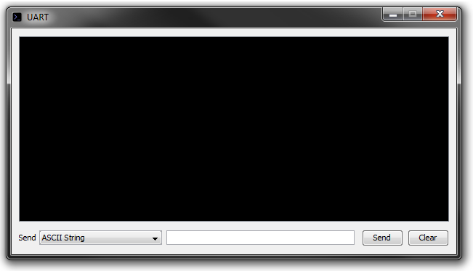
PLPTool Interface
Simulates external UART device connected to PLP UART

Slide 4
UART
Universal Asynchronous Receiver/Transmitter
Used for serial communication
At most one wire per direction of data
Sent sequentially one bit at a time

Slide 5
UART
Other common serial interfaces include:
USB
SATA
RS-232
SPI
I²C

Slide 6
ASCII
Computers only “understand” binary so how are characters represented?
ASCII character encodings
American Standard Code of Information Interchange

Slide 7
ASCII
Each character is represented by 7-bit value
Numbers start sequentially at 48 (0x30)
‘0’ is 0x30
‘9’ is 0x39
‘;’ has the value 59 (0x3B)

Slide 8
Character Strings
Sequence of characters
Null terminated string ends with a null character (‘\0’)
Has an ASCII value of zero
Terminating character can be any character agreed upon by sender and receiver

Slide 9
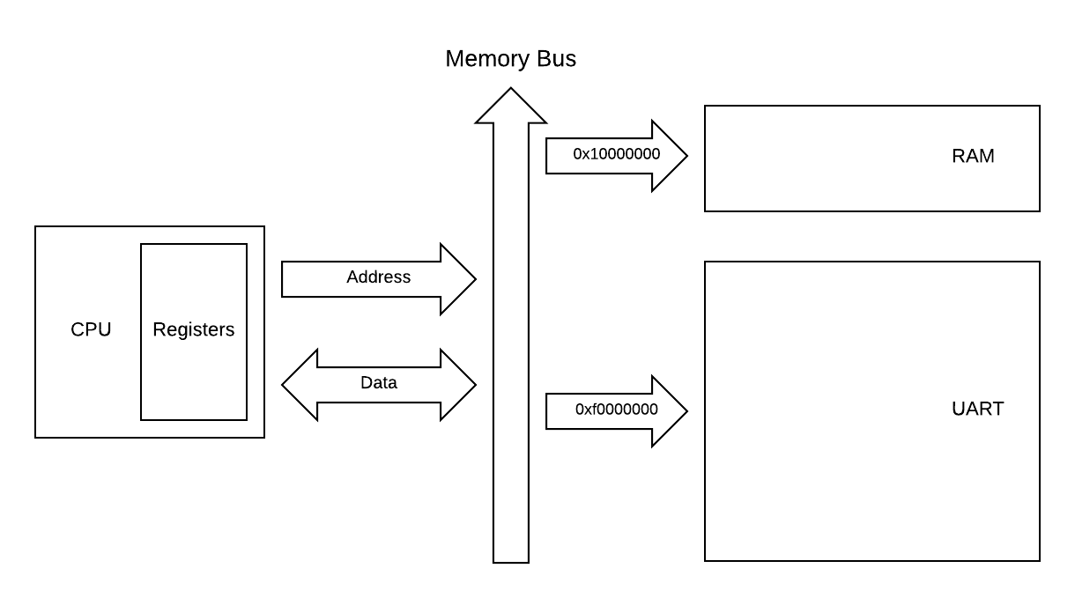
I/O Device: UART

Slide 10
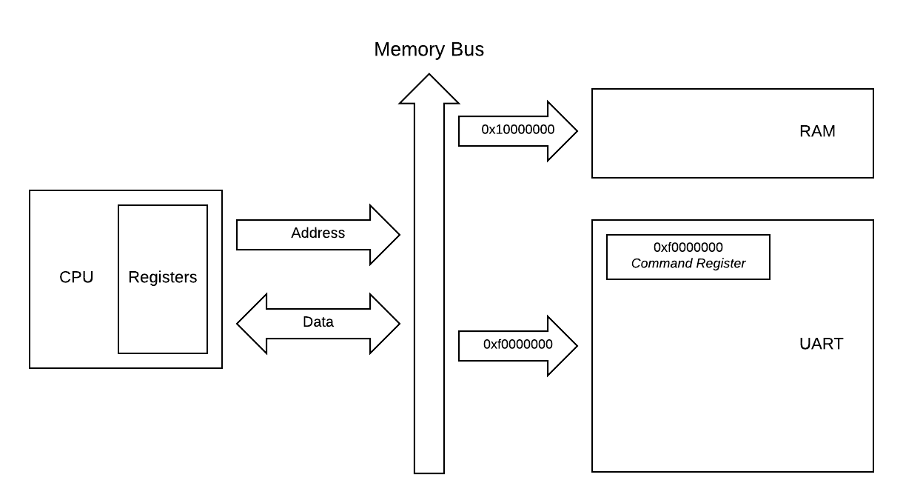
I/O Device: UART

Slide 11
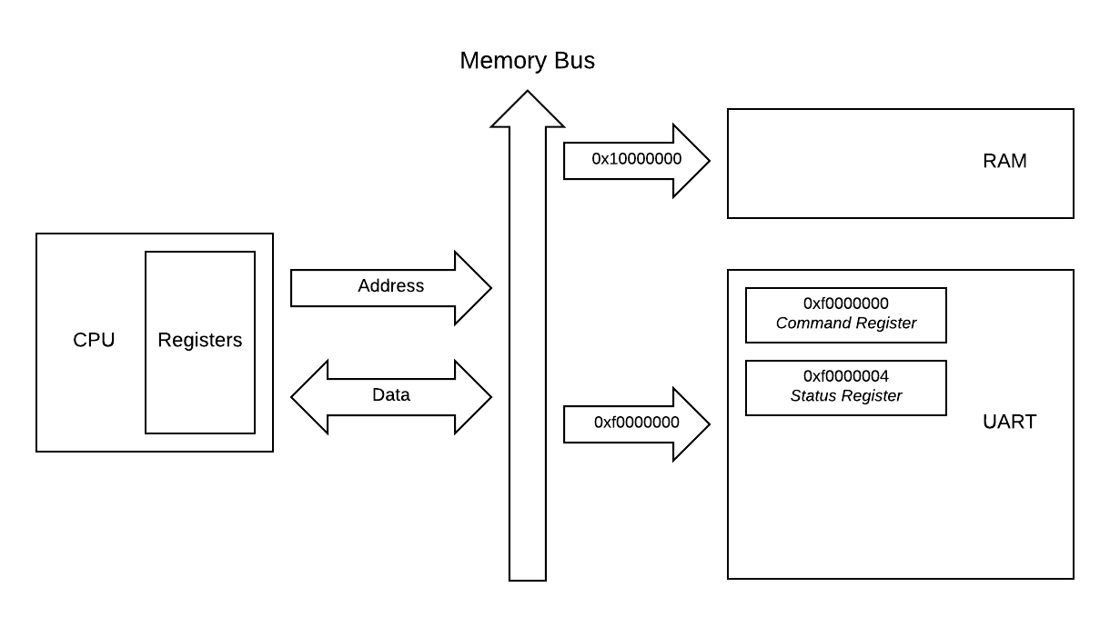
I/O Device: UART

Slide 12
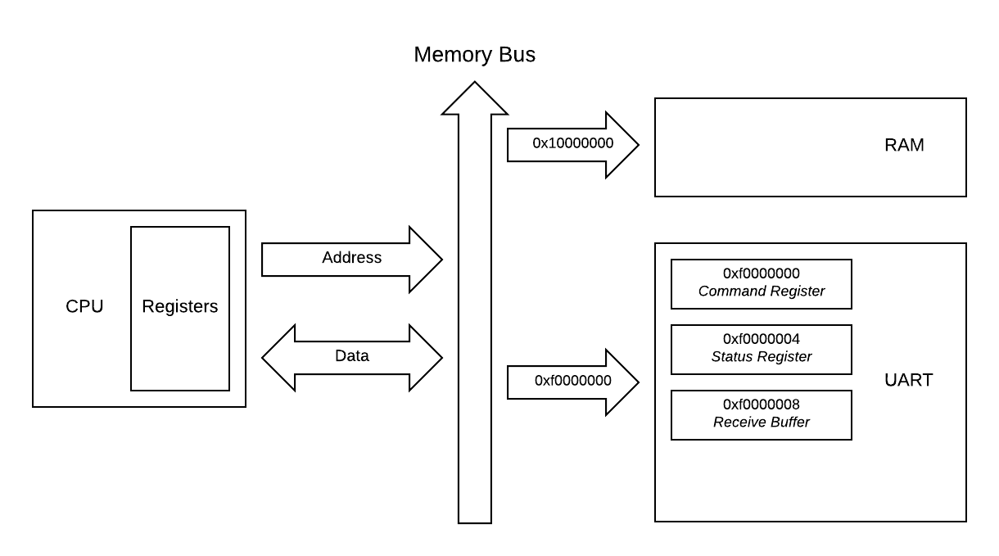
I/O Device: UART

Slide 13

I/O Device: UART

Slide 14
UART Registers
Command register (0xf0000000)
Write-only
Bit at 2¹ position: clear status bit
Used to indicate to UART that your program has read current byte
Status register (0xf0000004)
Read-only
Bit at 2¹ position: ready bit
Indicates a byte has been received by the UART

Slide 15
UART Buffers
Receive buffer (0xf0000008)
Read-only
Contains most recent byte received by UART
Send buffer (0xf000000c)
Not used in Project 3

Slide 16
Polling
Also called busy waiting
Loop waiting for an I/O device status to change to a specific condition
Exit loop when condition is met
Poll UART ready bit waiting for new character

Slide 17
I/O Device: UART
PLP
PLP UART
Command Register
External Device
UART
(PLPTool GUI UART)
RX
TX
Status Register: 0b01
TX
RX
Receive Buffer: 0x00

Slide 18
I/O Device: UART
PLP
PLP UART
Command Register
External Device
UART
(PLPTool GUI UART)
RX
TX
Status Register: 0b01
TX
RX
Receive Buffer: 0x00
Send buffer:
1
5
;

Slide 19
I/O Device: UART
PLP
PLP UART
Command Register
External Device
UART
(PLPTool GUI UART)
RX
TX
Status Register: 0b01
TX
RX
Receive Buffer: 0x31
Send buffer:
5
;

Slide 20
I/O Device: UART
PLP
PLP UART
Command Register
External Device
UART
(PLPTool GUI UART)
RX
TX
Status Register: 0b11
TX
RX
Receive Buffer: 0x31
Send buffer:
5
;

Slide 21
I/O Device: UART
PLP
PLP UART
Command Register
External Device
UART
(PLPTool GUI UART)
RX
TX
Status Register: 0b11
TX
RX
Receive Buffer: 0x31
0x31
Send buffer:
5
;

Slide 22
I/O Device: UART
PLP
PLP UART
Command Register
0b10
External Device
UART
(PLPTool GUI UART)
RX
TX
Status Register: 0b11
TX
RX
Receive Buffer: 0x31
Send buffer:
5
;

Slide 23
I/O Device: UART
PLP
PLP UART
Command Register
0b10
External Device
UART
(PLPTool GUI UART)
RX
TX
Status Register: 0b01
TX
RX
Receive Buffer: 0x31
Send buffer:
5
;

Slide 24
I/O Device: UART
PLP
PLP UART
Command Register
0b10
External Device
UART
(PLPTool GUI UART)
RX
TX
Status Register: 0b01
TX
RX
Receive Buffer: 0x31
Send buffer:
5
;

Slide 25
I/O Device: UART
PLP
PLP UART
Command Register
External Device
UART
(PLPTool GUI UART)
RX
TX
Status Register: 0b01
TX
RX
Receive Buffer: 0x35
Send buffer:
;

Slide 26
I/O Device: UART
PLP
PLP UART
Command Register
External Device
UART
(PLPTool GUI UART)
RX
TX
Status Register: 0b11
TX
RX
Receive Buffer: 0x35
Send buffer:
;

Slide 27
I/O Device: UART
PLP
PLP UART
Command Register
External Device
UART
(PLPTool GUI UART)
RX
TX
Status Register: 0b11
TX
RX
Receive Buffer: 0x35
0x35
Send buffer:
;

Slide 28
I/O Device: UART
PLP
PLP UART
Command Register
0b10
External Device
UART
(PLPTool GUI UART)
RX
TX
Status Register: 0b11
TX
RX
Receive Buffer: 0x35
Send buffer:
;

Slide 29
I/O Device: UART
PLP
PLP UART
Command Register
0b10
External Device
UART
(PLPTool GUI UART)
RX
TX
Status Register: 0b01
TX
RX
Receive Buffer: 0x35
Send buffer:
;

Slide 30
I/O Device: UART
PLP
PLP UART
Command Register
0b10
External Device
UART
(PLPTool GUI UART)
RX
TX
Status Register: 0b01
TX
RX
Receive Buffer: 0x35
Send buffer:
;

Slide 31
I/O Device: UART
PLP
PLP UART
Command Register
External Device
UART
(PLPTool GUI UART)
RX
TX
Status Register: 0b01
TX
RX
Receive Buffer: 0x3B
Send buffer:

Slide 32
I/O Device: UART
PLP
PLP UART
Command Register
External Device
UART
(PLPTool GUI UART)
RX
TX
Status Register: 0b11
TX
RX
Receive Buffer: 0x3B
Send buffer:

Slide 33
I/O Device: UART
PLP
PLP UART
Command Register
External Device
UART
(PLPTool GUI UART)
RX
TX
Status Register: 0b11
TX
RX
Receive Buffer: 0x3B
0x3B
Send buffer:

Slide 34
I/O Device: UART
PLP
PLP UART
Command Register
0b10
External Device
UART
(PLPTool GUI UART)
RX
TX
Status Register: 0b11
TX
RX
Receive Buffer: 0x3B
Send buffer:

Slide 35
I/O Device: UART
PLP
PLP UART
Command Register
External Device
UART
(PLPTool GUI UART)
RX
TX
Status Register: 0b01
TX
RX
Receive Buffer: 0x3B
Send buffer:

Slide 36
Bit Masking
Used to isolate specific bits in a value
Bit masking takes advantage of AND operation
Only the bits set in your mask are the ones that will be kept

Slide 37
Bit Masking
Example: put the isolate the third bit of $t0 in $t2
Create a mask
li $t1, 0b100
AND value register with mask
and $t2, $t0, $t1

Slide 38
Bit Masking
Example: put the isolate the third bit of $t0 in $t2
If $t0 contained 0b1101
Value
0b1101
Mask
0b0100
Result
0b0100

Slide 39
Bit Masking
Example: put the isolate the third bit of $t0 in $t2
If $t0 contained 0b0010
Value
0b0010
Mask
0b0100
Result
0b0000

Slide 40
Memory Access Offset
li $s0, 0xf0000000
Address | Contents
0xF0000000 | 0x00000000
0xF0000004 | 0x00000001
0xF0000008 | 0x00000000
0xF000000C | 0x00000000
$s0

Slide 41
Memory Access Offset
li $s0, 0xf0000000
lw $t1, 4($s0) #UART Status Register
Address | Contents
0xF0000000 | 0x00000000
0xF0000004 | 0x00000001
0xF0000008 | 0x00000000
0xF000000C | 0x00000000
$s0
$s0 + 4
Copied
$t1

Slide 42
Modularity and Comparisons

